Slide 1
End‑to‑End Clinical Reporting Pipeline in R
Raw Data → SDTM → ADaM → Interactive Dashboard

Slide 2
Agenda
Problem Statement
Pipeline Overview
SDTM Generation (sdtm.oak + metacore/metatools)
ADaM Creation (admiral)
TLF Dashboard (teal)
Validation Strategy
Next Steps / Deliverables

Slide 3
Clinical Trial Data Flow
1. {metacore} + {metatools} → SDTM Layer
{metacore}: Defines the study metadata and specifications
{metatools}: Uses these specifications to prepare and validate SDTM data
2. {admiral} → ADaM Layer
Takes the prepared SDTM data from {metatools}
Creates analysis-ready ADaM datasets following CDISC standards
3. {tern} → Analysis Layer
Uses the ADaM datasets to generate Tables, Listings, and Graphs
4. {teal} → Delivery Layer
Creates interactive applications using all of the above components
{metacore}: Metadata specification
{metatools}: SDTM data preparation
{admiral}: ADaM dataset creation
{tern}: Statistical analysis and TLGs
{teal}: Interactive applications
{rtables}: Table formatting engine
{xportr}: validation checks
Raw Data (CDISC OAK)
↓
sdtm.oak → SDTM (DM, AE, EX, DS)
↓
admiral → ADaM (ADSL, ADAE, ADTTE)
↓
teal → Interactive Dashboard
↓
xportr → Validation + XPT export

Slide 4
Package | Primary Role | Key Validation / Core Feature
{metacore} | Holds study metadata & specifications | Reads P21 specs; provides controlled terms
{metatools} | SDTM creation & validation | check_ct_data() – CT compliance; build_from_derived() – automated derivations
{admiral} | ADaM dataset creation | use_ad_template() – standard ADaM structures; traceable derivations
{teal} | Interactive dashboard | Filter panels, modular TLF modules
{xportr} | CDISC conformance & XPT export | Enforces names ≤8, labels ≤40, types, lengths; writes v5 XPT
{sdtmchecks} | Cross‑domain consistency | DM vs. AE vs. EX – automated checks
{diffdf} | Dataset comparison | Raw → SDTM → ADaM reconciliation
{dplyr} / {survival} | Independent validation | Compare dashboard counts/KM estimates

Slide 5
SDTM.OAK Programming Steps
Raw Datasets → pharmaverseraw::ae_raw, dm, ds, ec, vs
Read Raw datasets
Create id vars in the raw dataset
Read study controlled terminology
Map Topic Variable
Map Rest of the variables
Repeat Map topic and Map rest for every topic variable
Create SDTM derived variables
Add Lables and Attributes

Slide 6
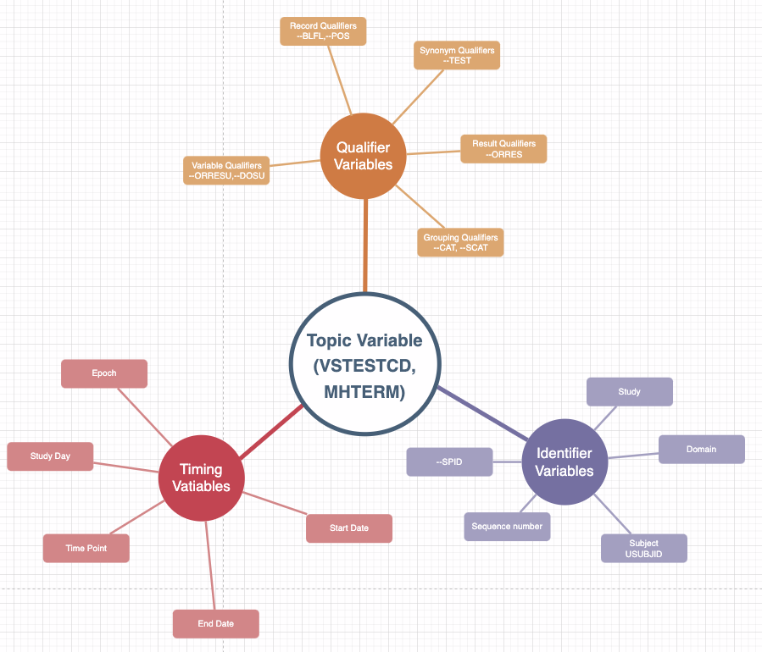
SDTM

Slide 7
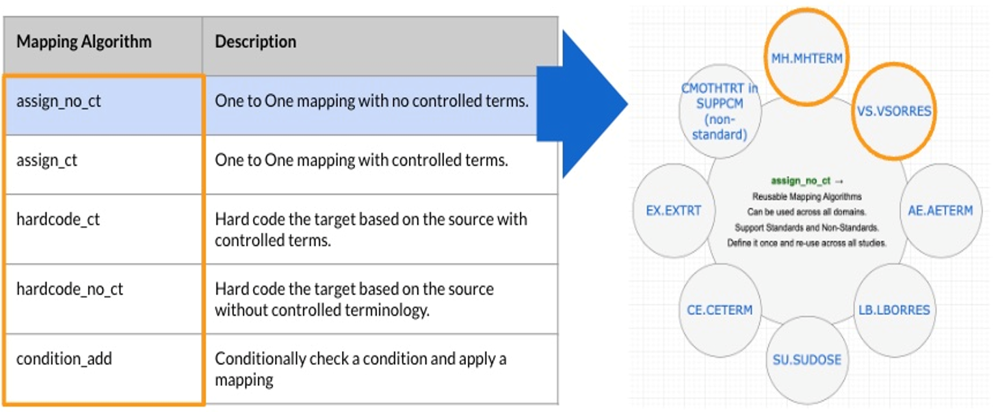
{SDTM.OAK}

Slide 8






ADaM Work Flow
Import metadata
Combine predecessor variables
Do any calculations
Drop unused variables
Import data
Export dataset

Slide 9
{tfrmt}
 |  | Placebo (N = XX) | Treatment (N = XX) | Total (N = XX)
Age (y) | n | XX | XX | XX
 | Mean (sd) | XX.X(XX.XX) | XX.X(XX.XX) | XX.X(XX.XX)
 | Median | XX.X | XX.X | XX.X
 | Min, Max | XX,XX | XX,XX | XX,XX
 | <65 yrs | XX (XX.X%) | XX (XX.X%) | XX (XX.X%)
 | 65-80 yrs | XX (XX.X%) | XX (XX.X%) | XX (XX.X%)
 | >80 yrs | XX (XX.X%) | XX (XX.X%) | XX (XX.X%)
Sex | n | XX | XX | XX
 | Male | XX (XX.X%) | XX (XX.X%) | XX (XX.X%)
 | Female | XX (XX.X%) | XX (XX.X%) | XX (XX.X%)
Columns
Row groups
Labels and groups
Table body
tfrmt(…,
group = “var1”,
label = “var2”,
body_plan = body_plan(),
col_plan = col_plan(),
row_grp_plan = row_grp_plan()
)

Slide 10
Value formatting
body_plan(
frmt_structure(
group_val = ".default",
label_val = ".default",
frmt_combine("{n} ({pct}%)",
n = frmt("X"),
pct = frmt("xx.x")
)
),
frmt_structure(
group_val = ".default",
label_val = "n",
frmt("XX")),
frmt_structure(
group_val = "Age (y)",
label_val = "Mean (sd)",
frmt_combine("{mean}({SD})",
mean = frmt("XX.X"),
SD = frmt("x.xx")
)
)
)
Group | Label | Column | Param | Value
Age (y) | n | Placebo | n | 15.00
Age (y) | n | Treatment | n | 13.00
Age (y) | n | Total | n | 28.00
Sex | n | Placebo | n | 14.00
Sex | n | Treatment | n | 13.00
Sex | n | Total | n | 27.00
Age (y) | Mean (sd) | Placebo | mean | 73.56
Age (y) | Mean (sd) | Treatment | mean | 74.231
Age (y) | Mean (sd) | Total | mean | 71.84
Age (y) | Mean (sd) | Placebo | SD | 9.347
Age (y) | Mean (sd) | Treatment | SD | 7.234
Age (y) | Mean (sd) | Total | SD | 8.293
 |  | Placebo | Treatment | Total
Age (y) | n | 15 | 13 | 28
 | Mean (sd) | 73.6(9.35) | 74.2(7.23) | 71.8(8.29)
Sex | n | 14 | 13 | 27
 | Male | 8 (57.1%) | 7 (53.8%) | 15 (55.6%)
 | Female | 6 (48.2%) | 6 (46.1%) | 12 (44.4%)

Slide 11
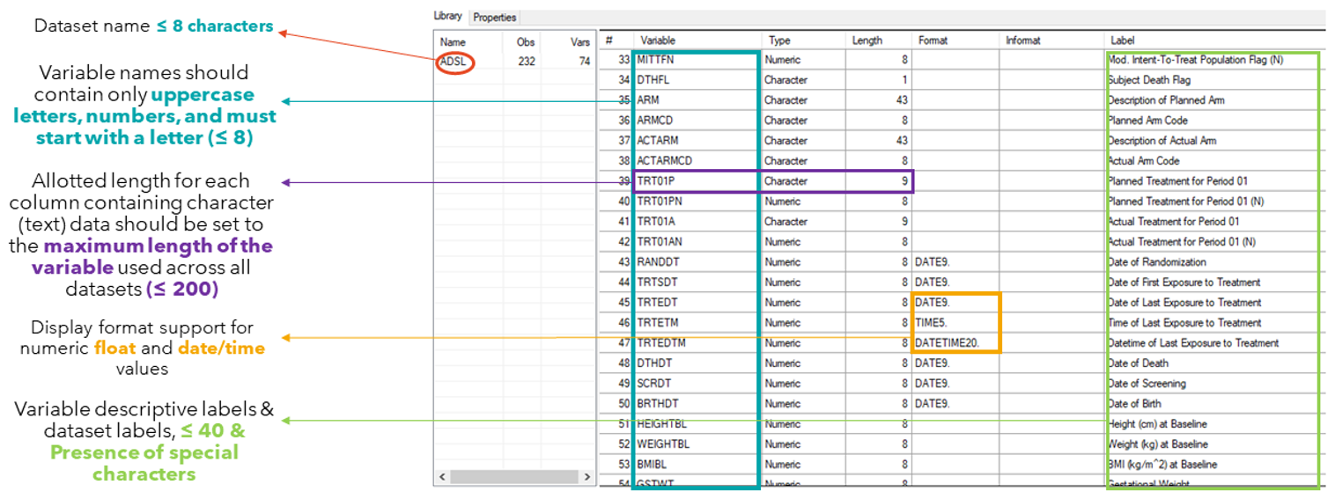
Apply types
Apply lengths
Apply variable labels
Apply formats
Re-order the variables
Apply a dataset label
Write out a version 5 xpt file
Validation Checks
v5 xpt ADSL dataset validation

Slide 12
Phase | What We Check | R Package
SDTM | Controlled terms, duplicate USUBJID, required variables, domain structure | {metatools}, {sdtmchecks}
ADaM | Variable names ≤8, labels ≤40, no non‑ASCII, correct types/lengths, dataset label ≤40 | {xportr}
ADSL vs. DM | Subject‑level consistency (counts, keys, death dates, treatment flags) | {diffdf}
Dashboard | Counts, means, KM estimates vs. independent R calculations | {dplyr}, {survival}
Final XPT | Write CDISC v5 XPT, enforce metadata, generate validation log | {xportr}
All checks produce a consolidated pass/fail log – no manual intervention. Each validation step is version‑controlled and runs automatically within the targets pipeline. End‑to‑end validation report generated with timestamps, dataset versions, and pass/fail status.

Slide 13
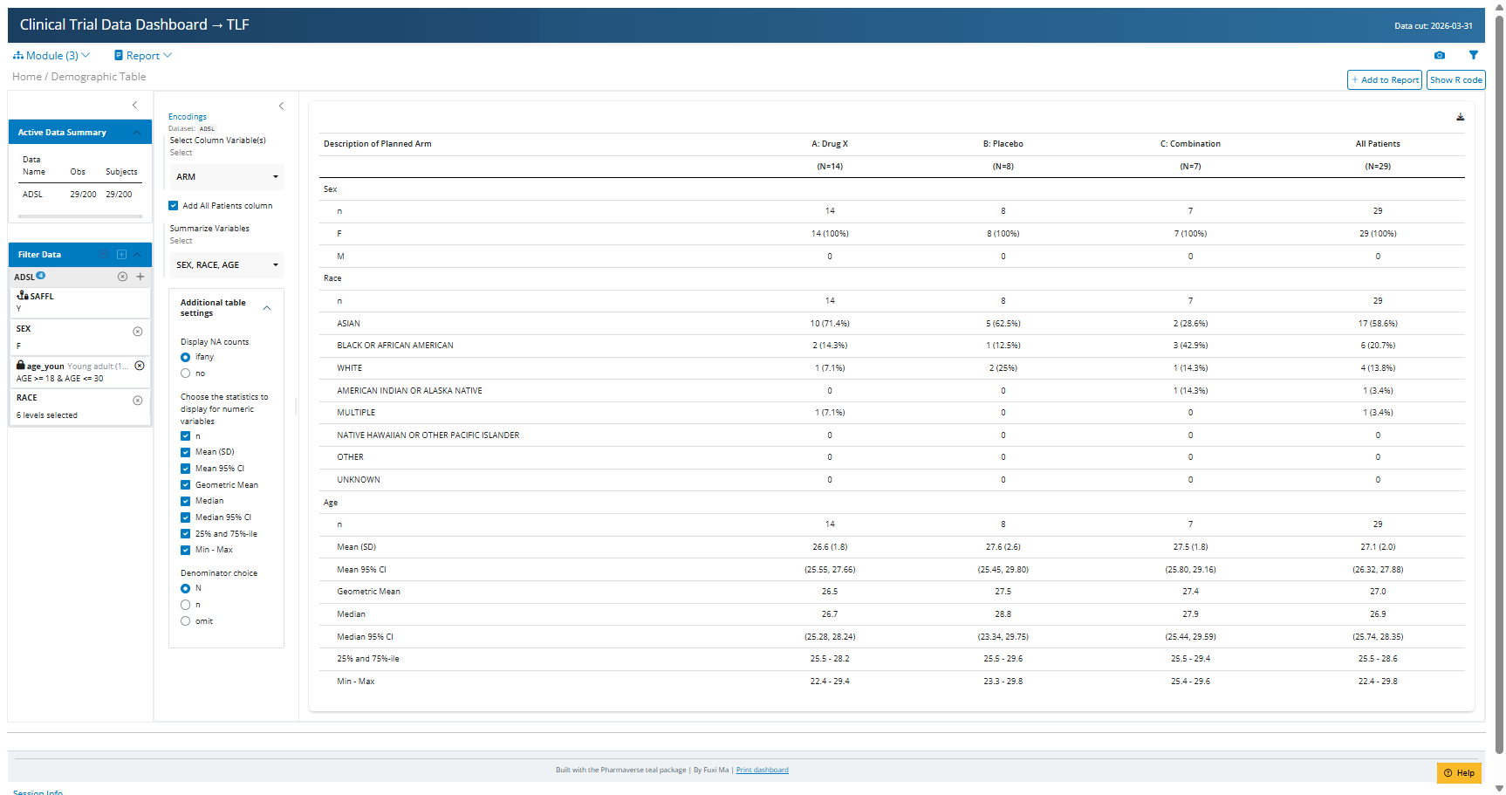

Slide 14
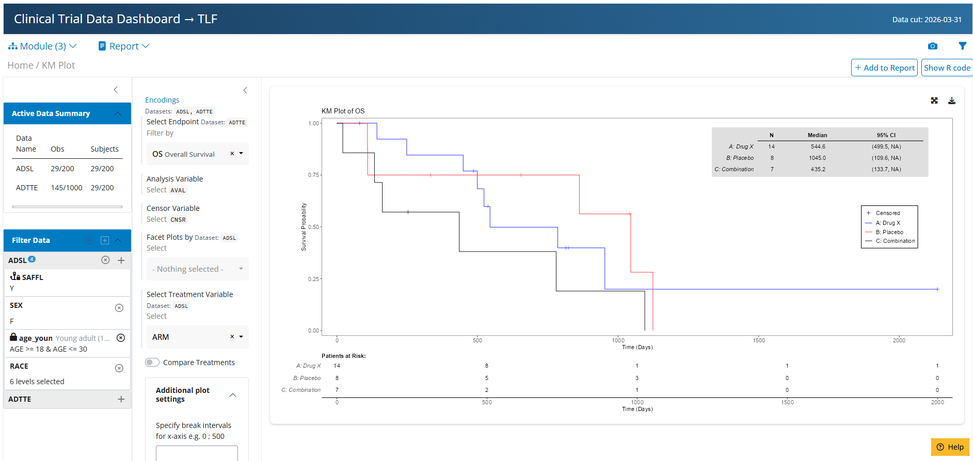

Slide 15
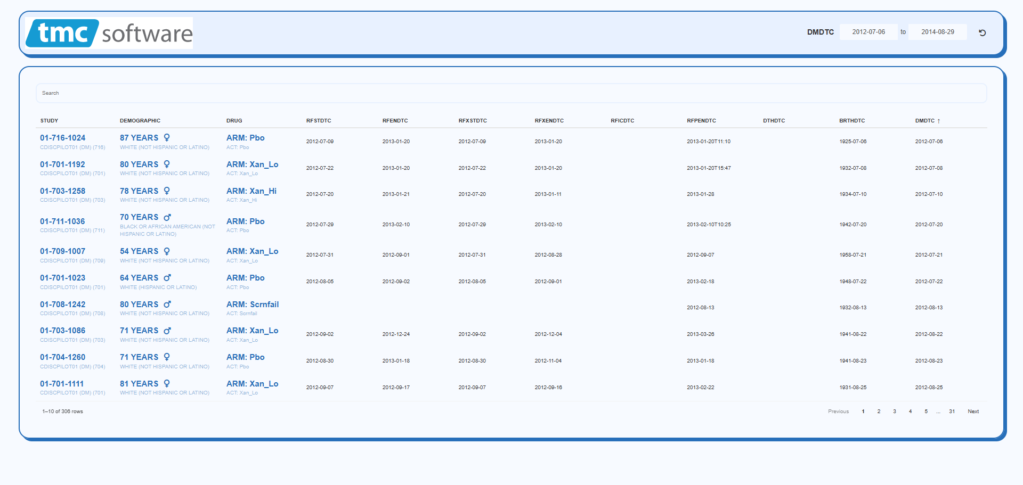

Slide 16
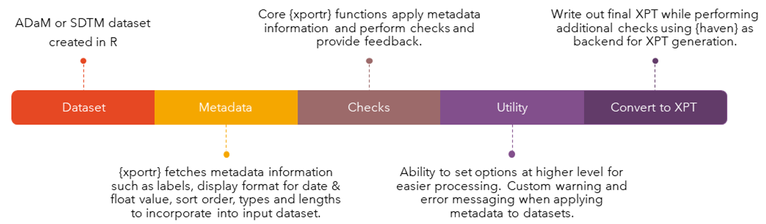
Validation Checks
{xportr}
Variable names must start with a letter (not an underscore), be comprised of only uppercase letters (A-Z), numerals (0-9) and be free of non-ASCII characters, symbols, and underscores.
Allotted length for each column containing character (text) data should be set to the maximum length of the variable used across all data sets (≤ 200)
Coerces variables to only numeric or character types
Display format support for numeric float and date/time values
Variables names are ≤ 8 characters.
Variable labels are ≤ 40 characters.
Data set labels are ≤ 40 characters.
Presence of non-ASCII characters in Variable Names, Labels or data set labels.

Slide 17
What This Means for You
Reproducible – One script runs from raw data to dashboard. No black boxes.
CDISC compliant – SDTM, ADaM, and v5 XPT ready for submission.
Fully validated – Every step has automated checks with a clear pass/fail log.
Adaptable – Handles mixed CDASH/non‑CDASH sources (like your VS domain) with minimal changes.
Interactive – Stakeholders can explore data without writing R code.
Auditable – Timestamped validation reports for regulatory review.

Slide 18
Appendix – Detailed Function Lists
{metatools}
build_from_derived()
Builds a dataset based on all predecessors
combine_supp()
Combines supps and domains
create_var_from_codelist()
Creates a new variable based on code/decode
create_cat_var()
Creates a categorial variable from continues based on codelist
order_cols()
Orders the columns per metadata definitions
set_variable_labels()
Adds labels to all columns per metadata definitions
check_ct_data()
Checks all values fall within control terms
{metacore}
spec_to_metacore()
Reads a P21 spec into metacore
select_dataset()
Select a single dataset of metadata
get_control_term()
Pulls out the control terms for a variable
{Tplyr} Create standard descriptive statistics from ADAMs
tplyr_table()
Setup a table
add_layer()
Adds a layer to build descriptive stats on
group_count()
Calculates count based descriptive stats
group_desc()
Calculates continuous descriptive stats
add_total_group()
Adds totals column
get_numeric_data()
Pulls out an ARD from a Tplyr table
set_distinct_by()
Sets how to count distinct subjects
{tfrmt} ARDs (Analysis Result Datasets)
tfrmt()
Setup a table
body_plan()
Defines the body of the table
frmt_structure()
Defines which rows to apply formatting to
frmt_combine()/frmt_when()/frmt()
Defines the formatting
col_plan()
Sets column appearance
row_grp_plan()
Defines the style for each group
print_mock_gt()
Prints to gt without data to produce a mock
print_to_gt()
Prints to gt with data to make final table
{admiral} :
derive_vars_merged_dtm()
Merge and impute datetime variables
derive_var_merged_exist_flag()
Merge an existing flag
compute_bmi()
Computes BMI
derive_var_base()
Creates a baseline column from flag

Slide 19
Appendix – CARDINAL → QC Table via ARD tbl_summary() tbl_hierarchical() tbl_continuous() tbl_wide_summary() tbl_ard_summary() tbl_ard_hierarchical() tbl_ard_continuous() tbl_ard_wide_summary()

Slide 20
Appendix – pharmaverse SDTM-IG3.4
GitHub - pharmaverse/pharmaverse: Website: https://pharmaverse.org/ · GitHub
GitHub - pharmaverse/admiral: ADaM in R Asset Library · GitHub
GitHub - pharmaverse/admiraltemplate: Recommended Structure for admiral R package extensions · GitHub
GitHub - pharmaverse/metatools · GitHub
GitHub - pharmaverse/pharmaversesdtm: Test SDTM data for use within the pharmaverse family of packages · GitHub
GitHub - pharmaverse/sdtmchecks: Analysis facing checks for SDTM data · GitHub
GitHub - pharmaverse/sdtm.oak-workshop: sdtm.oak workshop · GitHub
GitHub - pharmaverse/metatools · GitHub
GitHub - pharmaverse/tealworkshop-phusecss2025 · GitHub
Cardinal
R4SUB
RAWDATA Non_CDASH-raw-data CDISC Data
R in Pharma - YouTube
GitHub - pharmaverse/intro-to-r-for-sas-programmers-workshop · GitHubGitHub - pharmaverse/end_to_end_examples: Repo of end to end examples of using the pharmaverse · GitHub
GitHub - pharmaverse/examples: End to end examples of pharmaverse packages for common safety clinical reporting analyses · GitHub
GitHub - pharmaverse/pharmaverseraw: Test raw data for use within the pharmaverse family of packages · GitHub

